Slide 1
OpenGL for absolute beginners.

Slide 2
What is OpenGL?

Slide 3
From the Red book:
OpenGL is a software interface to graphics hardware.
Notes:
OpenGL is not a language. It's just a specification of an API that vendors implement on their platforms. So it is platform and language independent.
In your operating system the component that implements OpenGL is the graphics driver.

Slide 4
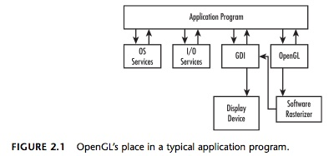
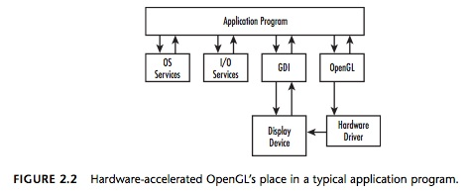
(Diagrams from the super bible)
Notes:
There are OpenGL implementations independent of any hardware. The OpenGL commands in such an implementation are handled by a software rasterizer which then sends the final image to the native graphics API.
On platforms that have OpenGL enabled hardware, OpenGL commands are directly sent to the display device.

Slide 5
A state machine.

Slide 6
glViewport (0, 0, w, h)
glMatrixMode (GL_PROJECTION)
glLoadIdentity ()
glFrustum (-1.0, 1.0, -1.0, 1.0, 1.5, 20.0)
glMatrixMode (GL_MODELVIEW)
glScalef (1.0, 2.0, 1.0)
Notes:
Most OpenGL commands are dependent on the current state of the OpenGL context. Note how we first change the current matrix mode and then apply transformations to it.

Slide 7

A pipeline.
(Illustration from the super bible)
Notes:
Note that all OpenGL commands are first buffered before they are processed.
Also note that this is very simplified version of the pipeline. We will see a detailed diagram later.

Slide 8
Client-server Architecture
Applications are clients.
Notes:
An OpenGL program is in theory a client. The results of the commands invoked by the client will be seen on a server. In most cases the client and the server are the same machine. But it is possible to separate them.

Slide 9
High Level.
Notes:
When drawing in OpenGL we don't think in terms of pixels at all. We specify our scene using primitives like points and lines in a coordinate system. OpenGL takes care of mapping them to actual pixel values.

Slide 10
Low Level.
Notes:
Though we don't have to worry about pixels, we still cannot draw objects directly. For instance, there aren't any OpenGL commands for even mundane things like drawing a cube or drawing a circle. Any object has to be specified using a set of primitives.

Slide 11
What it cannot do...

Slide 12
Can't open a window.
Notes:
Since OpenGL has to be platform independent, it leaves all the platform specific functions like windowing, I/O, audio etc. to the host operating system.

Slide 13
Can't handle user input.

Slide 14
Can't even draw sophisticated 3D models on it's own.
Notes:
Most of the detailed graphics that we see in games like Doom 3D are actually generated using other software like 3D studio Max, serialized and then loaded at runtime.

Slide 15
What can OpenGL do?

Slide 16
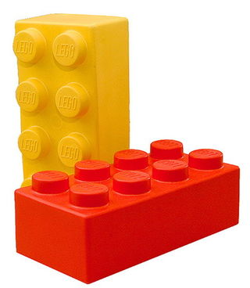
Think Lego (TM)
Notes:
Children build amazing structures using simple, unimpressive by themselves, and identical blocks. Another analogy is the bricks that are used to build sky scrapers and even the pyramids. The same principle applies to drawing objects with OpenGL.

Slide 17
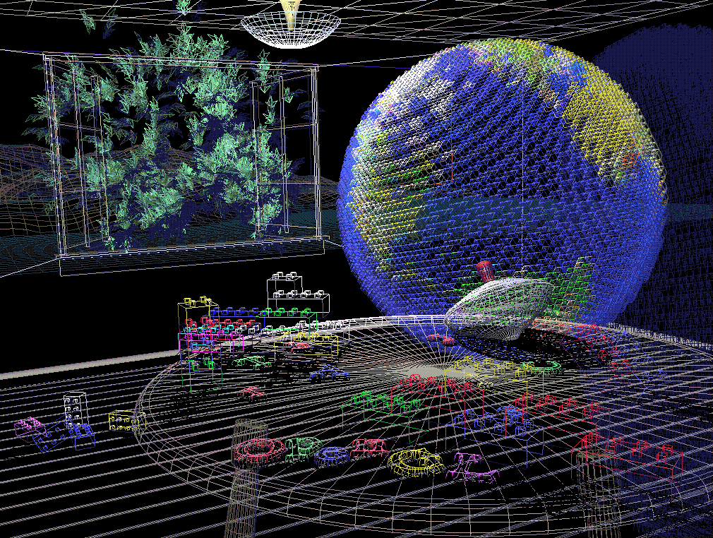
Wireframe model
Notes:
Plate 1 shows an entire scene displayed as a wireframe model—that is, as if all the objects in the scene were made of wire. Each line of wire corresponds to an edge of a primitive (typically a polygon). For example, the surface of the table is constructed from triangular polygons that are positioned like slices of pie.
Note that you can see portions of objects that would be obscured if the objects were solid rather than wireframe. For example, you can see the entire model of the hills outside the window even though most of this model is normally hidden by the wall of the room. The globe appears to be nearly solid because it’s composed of hundreds of colored blocks, and you see the wireframe lines for all the edges of all the blocks, even those forming the back side of the globe. The way the globe is constructed gives you an idea of how complex objects can be created by assembling lower-level objects.

Slide 18
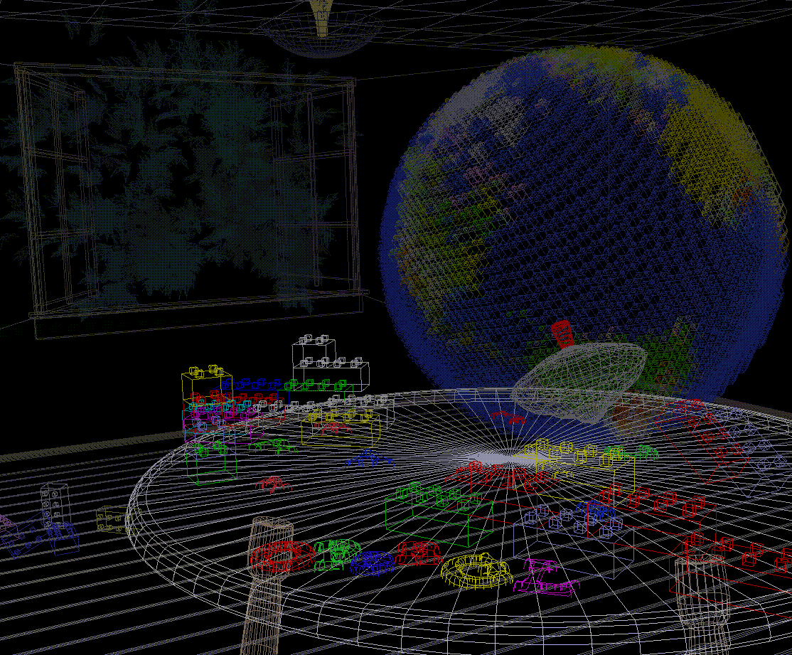
Wireframe model with depth cues
Notes:
Plate 2 shows a depth-cued version of the same wireframe scene. Note that the lines farther from the eye are dimmer, just as they would be in real life, thereby giving a visual cue of depth. OpenGL uses atmospheric effects (collectively referred to as fog) to achieve depth cueing.

Slide 19
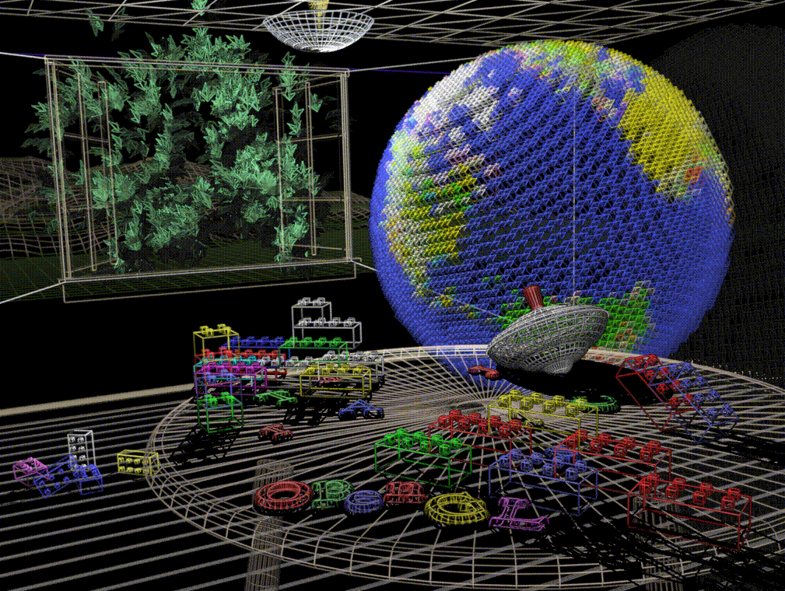
Anti aliasing
Notes:
Plate 3 shows an antialiased version of the wireframe scene. Antialiasing is a technique for reducing the jagged edges (also known as jaggies) created when approximating smooth edges using pixels—short for picture elements—which are confined to a rectangular grid. Such jaggies are usually the most visible, with near-horizontal or near-vertical lines.

Slide 20
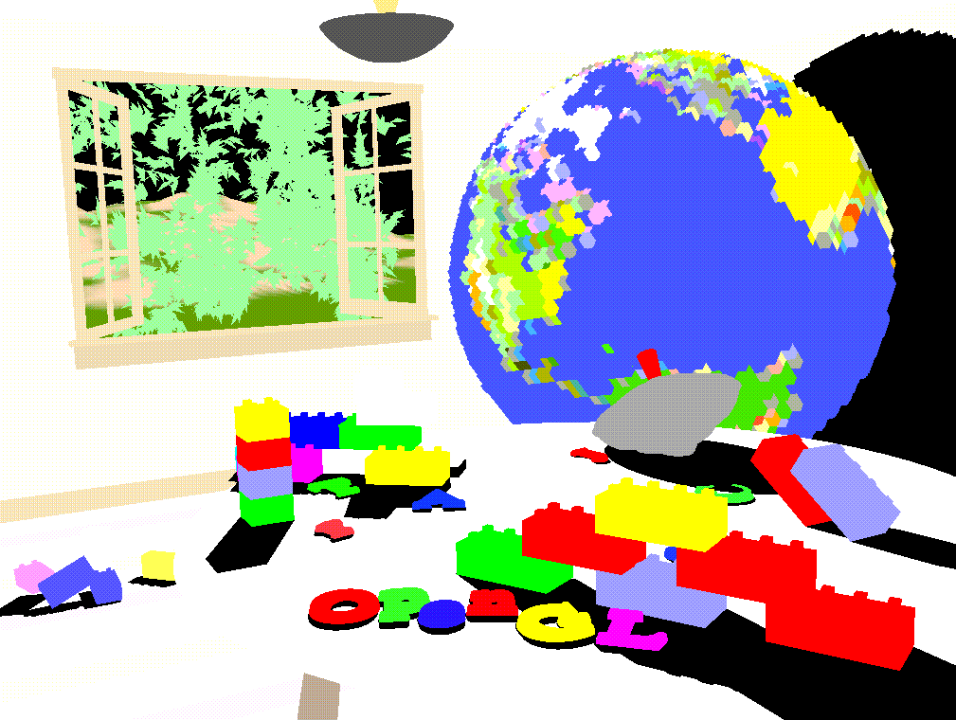
Color (Flat)
Notes:
Plate 4 shows a flat-shaded, unlit version of the scene. The objects in the scene are now shown as solid. They appear “flat” in the sense that only one color is used to render each polygon, so they don’t appear smoothly rounded. There are no effects from any light sources.

Slide 21
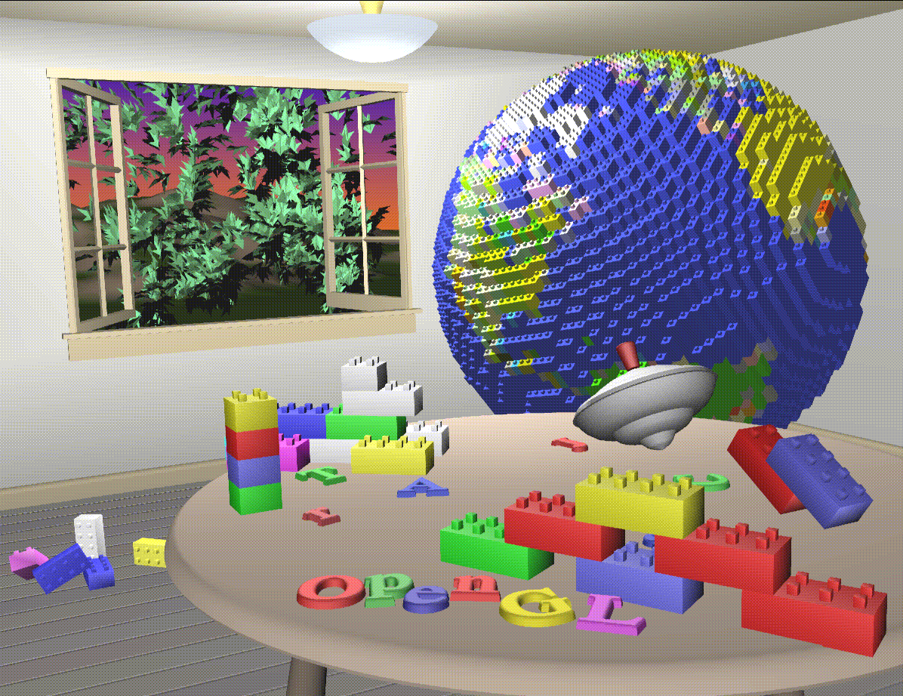
Lighting and smooth shading
Notes:
Plate 5 shows a lit, smooth-shaded version of the scene. Note how the scene looks much more realistic and three-dimensional when the objects are shaded to respond to the light sources in the room, as if the objects were smoothly rounded.

Slide 22
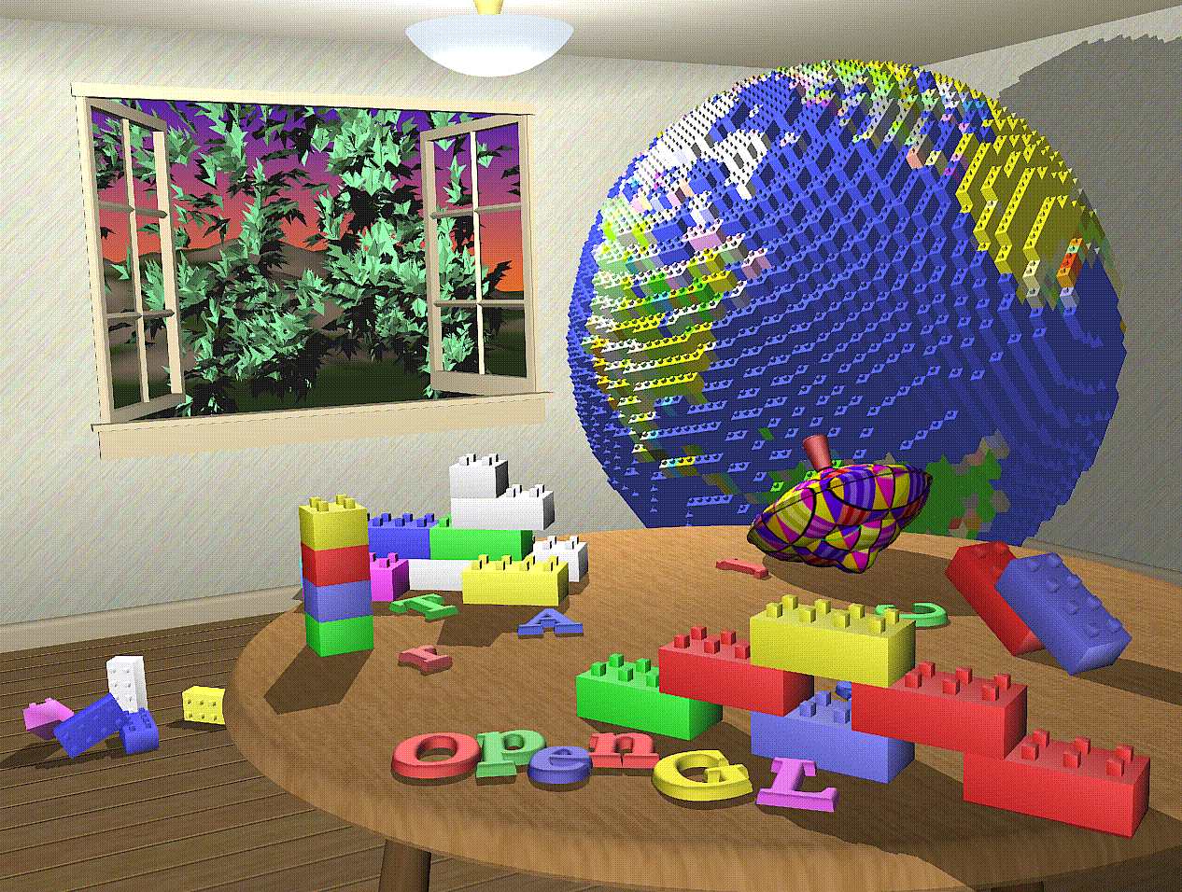
Textures and shadows
Notes:
Plate 6 adds shadows and textures to the previous version of the scene. Shadows aren’t an explicitly defined feature of OpenGL (there is no “shadow command”), but you can create them yourself using the techniques described in Chapter 9 and Chapter 14 of the red book. Texture mapping allows you to apply a two-dimensional image onto a three-dimensional object. In this scene, the top on the table surface is the most vibrant example of texture mapping. The wood grain on the floor and table surface are all texture mapped, as well as the wallpaper and the toy top (on the table).

Slide 23
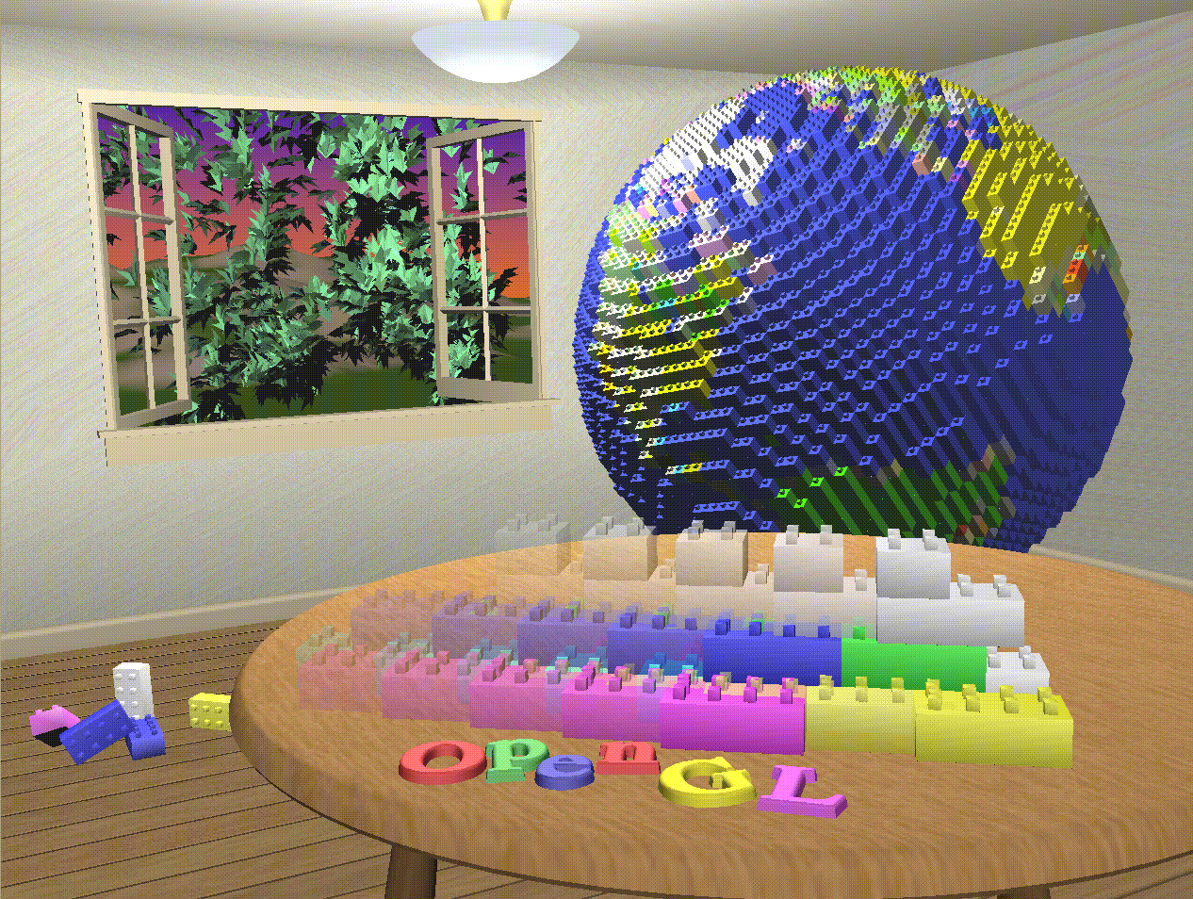
Motion blur
Notes:
Plate 7 shows a motion-blurred object in the scene. The sphinx appears to be captured moving forward, leaving a blurred trace of its path of motion.

Slide 24
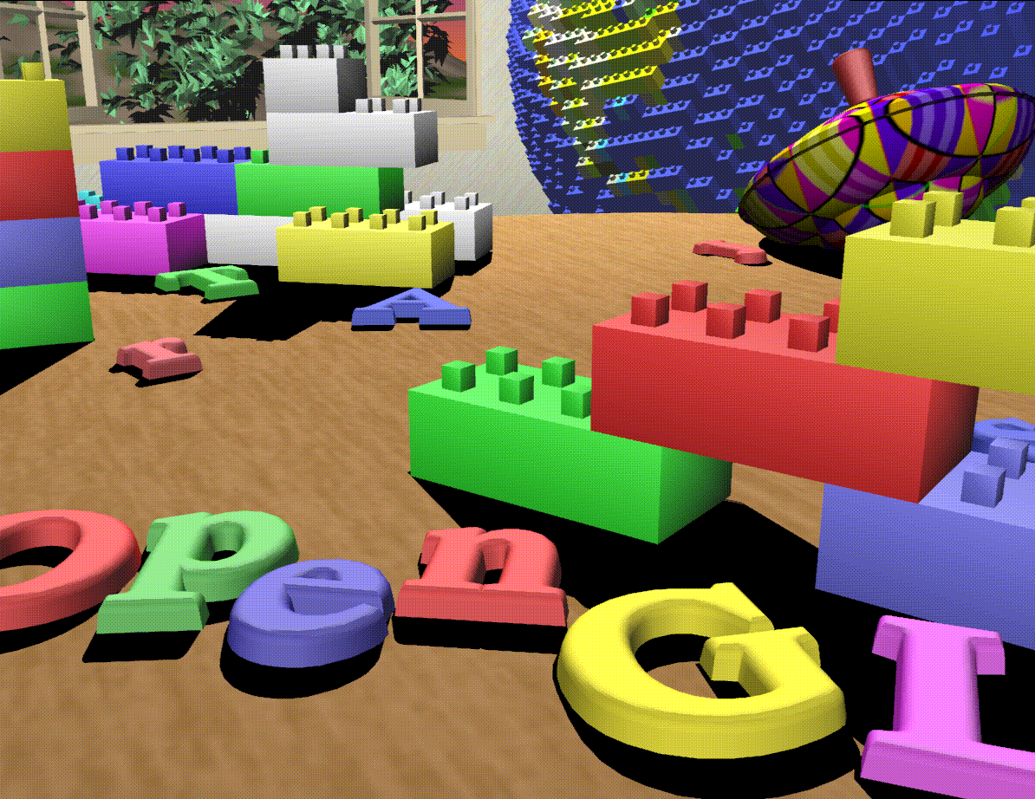
Zoom in
Notes:
Plate 8 shows the scene as it was drawn for the cover of the book from a different viewpoint. This plate illustrates that the image really is a snapshot of models of three-dimensional objects.

Slide 25
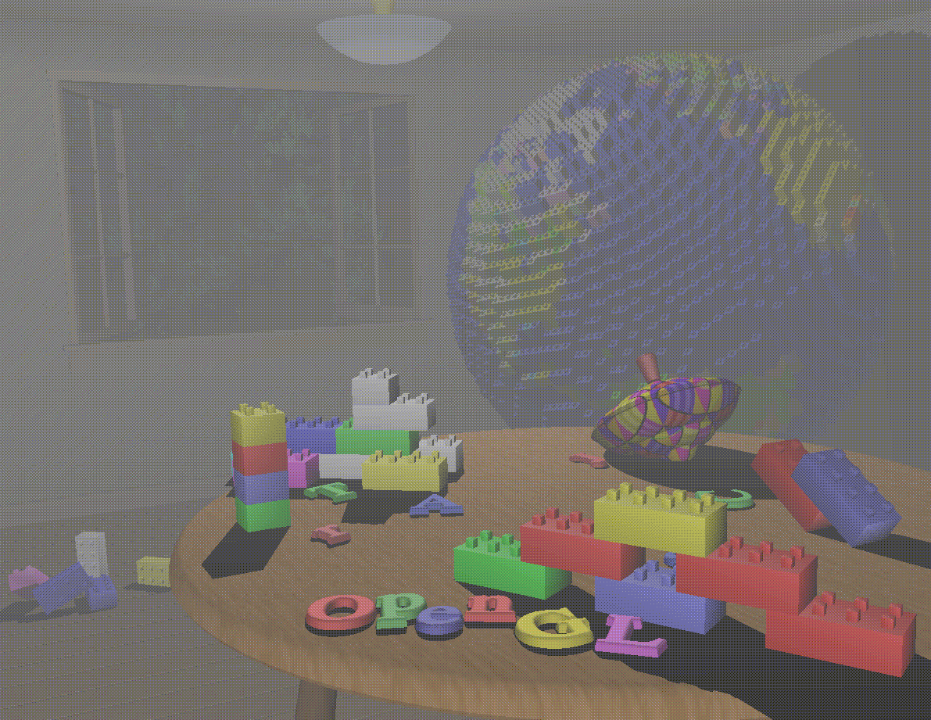
Effects
Notes:
Plate 9 brings back the use of fog, which was shown in Plate 2 to simulate the presence of smoke particles in the air. Note how the same effect in Plate 2 now has a more dramatic impact in Plate 9.

Slide 26
More at:
http://fly.cc.fer.hr/~unreal/theredbook/appendixj.html
Notes:
All the above images and illustrations were taken directly from the red book.

Slide 27
Disclaimer
Python, GLUT
Notes:
We use Python because that is the common factor among our team. Also, it is relatively easier to setup OpenGL with Python. For managing windows and I/O, we use GLUT as provided in the PyOpenGL module.
Note that there are other libraries like GLU, SDL, EGL, AGL, WGL and GLX that are widely used with OpenGL too, but we will avoid them.

Slide 28
Disclaimer
OpenGL ES code using OpenGL
Notes:
Since our target platforms are mostly mobile, desktop OpenGL is mostly irrelevant. Also, most desktop code uses OpenGL ES style code as a best practice anyway. But on a practical note we made this choice because each mobile platform has it's own method of setup and since our main aim is to learn the concepts we wanted to avoid too many specifics.

Slide 29
Hello OpenGL
Notes:
Here we'll look at a minimal OpenGL program. All it does is draw a point on the screen.

Slide 30
# clear all pixels
glClear(GL_COLOR_BUFFER_BIT)
# Specify the vertices (in this case just one) as an array, as in (x, y)
vertices = [0,0]
glVertexPointer(2, GL_SHORT, 0, vertices)
# Enable vertex arrays
glEnableClientState(GL_VERTEX_ARRAY)
# Set the drawing color
glColor3f(1, 0, 0)
# Draw the vertices
glDrawArrays(GL_POINTS, 0, 1)
# Disable vertex arrays
glEnableClientState(GL_VERTEX_ARRAY)
# don't wait!
# start processing buffered OpenGL routines
glFlush()

Slide 31
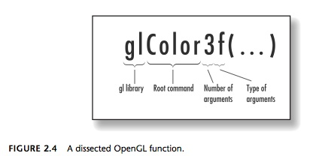
Notes:
All OpenGL function names conform to this convention.
The last two parts of the function, number of arguments and type of arguments, are optional.
Functions are usually known by their root name since multiple variations may exist.

Slide 32
Four points

Slide 33
# clear all pixels
glClear(GL_COLOR_BUFFER_BIT)
# Specify the vertices (in this case four) as an array, as in (x, y)
vertices = [-0.8,0.8, 0.8,0.8, 0.8,-0.8, -0.8,-0.8]
glVertexPointer(2, GL_FLOAT, 0, vertices)
# Enable vertex arrays
glEnableClientState(GL_VERTEX_ARRAY)
# Set the drawing color
glColor3f(1, 0, 0)
# Draw the vertices
glDrawArrays(GL_POINTS, 0, len(vertices)/2)
# Disable vertex arrays
glEnableClientState(GL_VERTEX_ARRAY)
# don't wait!
# start processing buffered OpenGL routines
glFlush();
Notes:
Drawing in OpenGL is a two step process:
Specify a list of points.
Join them.
It's akin to the many 'connect the dots' puzzles found in children's magazines.
Specifying four points first step in drawing a rectangle.

Slide 34
A rectangle

Slide 35
# clear all pixels
glClear(GL_COLOR_BUFFER_BIT)
# Specify the vertices (in this case four) as an array, as in (x, y)
vertices = [-0.8,0.8, 0.8,0.8, 0.8,-0.8, -0.8,-0.8]
glVertexPointer(2, GL_FLOAT, 0, vertices)
# Enable vertex arrays
glEnableClientState(GL_VERTEX_ARRAY)
# Set the drawing color
glColor3f(1, 0, 0)
# Draw the vertices
glDrawArrays(GL_LINE_LOOP, 0, len(vertices)/2)
# Disable vertex arrays
glEnableClientState(GL_VERTEX_ARRAY)
# don't wait!
# start processing buffered OpenGL routines
glFlush();
Notes:
Connect the four points in a loop to draw a rectangle.

Slide 36
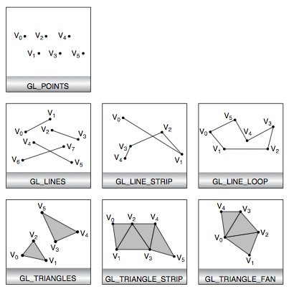
Drawing primitives
Notes:
As said before, OpenGL can only draw a few predefined primitives. The ones supported by OpenGL ES are points, lines, line strip, line loop, triangles, triangle strip and triangle fan.
No matter how complex your final objects needs to be, it will have to be constructed from these primitives.

Slide 37
# Declare initial window size, position, and display mode
# (single buffer and RGBA). Open window with "hello"
# in its title bar. Call initialization routines.
# Register callback function to display graphics.
# Enter main loop and process events.
glutInit(sys.argv)
glutInitDisplayMode(GLUT_SINGLE | GLUT_RGB)
glutInitWindowSize(250, 250)
glutInitWindowPosition(100, 100)
glutCreateWindow("hello")
glutDisplayFunc(display)
glutMainLoop()
Notes:
Pay attention to these lines (you'll find them in the end of the file)
They are not OpenGL functions, they belong to the GLUT API.

Slide 38
GLUT (OpenGL Utility Toolkit):

Slide 39
Animation

Slide 40
def display(i):
# clear all pixels
glClear(GL_COLOR_BUFFER_BIT)
# Prevent the box from going out of the screen
clipToWindow()
glMatrixMode(GL_MODELVIEW)
glLoadIdentity()
glTranslate(xPosition, yPosition, 0);
# Specify the vertices (in this case just one) as an array, as in (x, y)
vertices = [0, 0,
0, 50,
50, 50,
50, 0]
glVertexPointer(2, GL_FLOAT, 0, vertices)
# Enable vertex arrays
glEnableClientState(GL_VERTEX_ARRAY)
# Set the drawing color
glColor3f(1, 0, 0)
# Draw the vertices
glDrawArrays(GL_TRIANGLE_FAN, 0, len(vertices)/2)
# Disable vertex arrays
glEnableClientState(GL_VERTEX_ARRAY)
# Swap the buffers (glFLush() implicit)
glutSwapBuffers();
# Compute the new position
updatePosition()
glutTimerFunc(t, display, 1)

Slide 41
def reshape(width, height):
# Setup the drawing area (bottomX bottomY, topX, topY)
glViewport(0, 0, width, height)
# Update the screen width and height
global screenWidth, screenHeight
screenWidth = width
screenHeight = height
# Define the clipping volume (left, right, bottom, top, near, far)
glMatrixMode(GL_PROJECTION)
glLoadIdentity()
glOrtho(0, width, 0, height, -1, 1);
# Initialize the model-view matrix
glMatrixMode(GL_MODELVIEW)
glLoadIdentity();

Slide 42
Setting up the canvas.

Slide 43
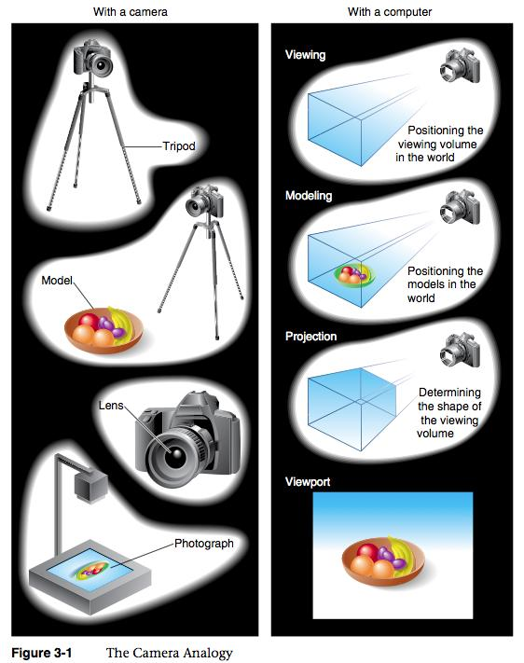
The Camera Analogy
(Illustration from the red book)

Slide 44
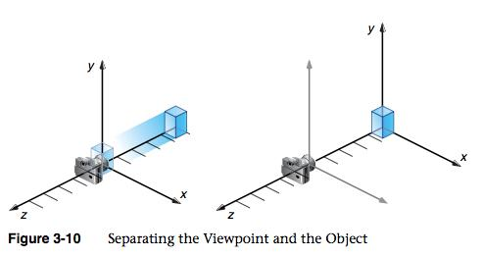
The duality of model and view.
(Illustration from the red book)

Slide 45
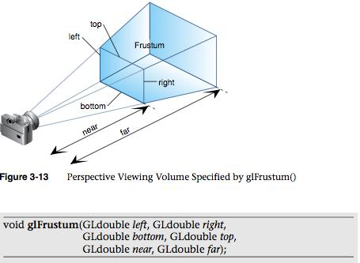
Perspective projection
(illustration from the red book)

Slide 46
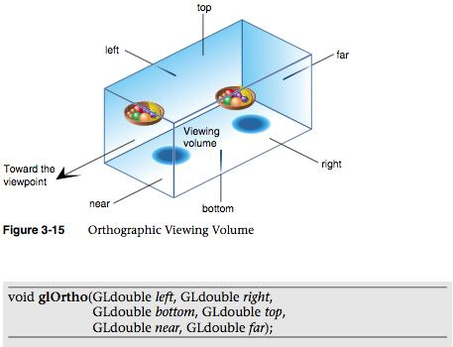
Orthographic Projection
(illustration from the red book)

Slide 47
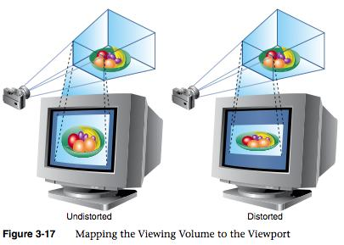
Viewport transformation
(illustration from the red book)

